Slide 1






E-COMMERCE SALES ANALYSIS
Student Details
Name: B premkumar
NM Id: au612721105026
College Name: THE KAVERY ENGINEERING COLLEGE
Title: E-COMMERCE SALES ANALYSIS

Slide 2
Disclaimer
The content is curated from online/offline resources and used for educational purpose only

Slide 3

Course Outline
Abstract
Problem Statement
Aims, Objective & Proposed System/Solution
System Deployment Approach
Model Development & Algorithm
Future Scope
Video of the Project
Conclusion
Reference

Slide 4

Abstract
In the emerging global economy, E-commerce is a strong catalyst for economic development. The rapid growth in usage of Internet and Web-based applications is decreasing operational costs of large enterprises, extending trading opportunities and lowering the financial barriers for active ecommerce participation.Business tycoons around the globe are realizing that e-commerce is not just trading of products and information over Internet, rather it provides an opportunity to compete with other giants in the market. Data mining (DM) is used to attain knowledge from available information in order to help companies make weighted decisions.

Slide 5

Problem Statement
E-commerce provides an easy way to sell products to a large customer base. However, there is a lot of competition among multiple e-commerce sites. When users land on an e-commerce site, they expect to find what they are looking for quickly and easily. Also, users are not sure about the brands or the actual products they want to purchase.
They have a very broad idea about what they want to buy. Many customers nowadays search for their products on Google rather than visiting specific e-commerce sites. They believe that Google will take them to the e-commerce sites that have their product.

Slide 6

Aim and Objective
Aim: Ecommerce is a method of buying and selling goods and services online. The definition of ecommerce business can also include tactics like affiliate marketing.

Slide 7
Objectives
Emotion detection : Emotion detection is an advanced technique that deploys advanced technologies like Machine Learning, Natural language Processing, Computer Vision, Image Processing, and many more to identify hidden emotions.
Age Estimation Model: Develop an age estimation model utilizing facial features, wrinkles, and other age-related cues to categorize individuals into specific age ranges.
Real-time Processing Optimization: The rate at which the companies have been collecting user data is simply tremendous as they consider it to be a valuable source to make improvements in their business strategies.
Robustness to Variability: Enhance the system's robustness to variations in lighting conditions, image quality, and camera angles.
User Interface Integration: Develop a user-friendly interface for seamless interaction with the system.
Scalability and Adaptability: Even a moderately successful e-commerce operation will grow year-over-year.

Slide 8

Proposed Solution
Solution: The project involves utilization of Convolutional Neural Networks (CNNs) for facial emotion age recognition.
Integration of pre-trained age detection models based on CNN architectures.
Implementation of efficient data preprocessing techniques for enhanced performance.
Deployment of optimized model architectures for real-time processing on resource-constrained devices.
Notes:
8

Slide 9
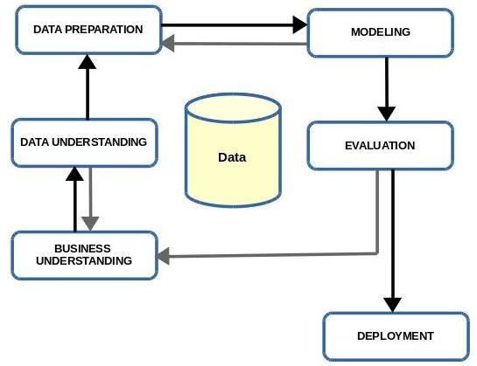
System Deployment Approach
Notes:
9

Slide 10
Thank you!
Notes:
10

